Slide 1
Sprint #5
Team Members
Brandon Tu, Affan Khan, Himmat Mahal , Chris Fitzgerald, Mussab Bin Imran , and Ibrahim Rather

Slide 2
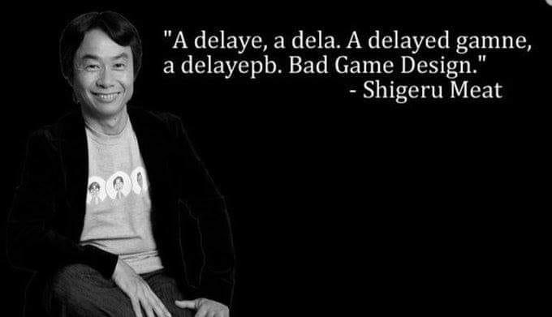
"Java is to Javascript, like Car is to Carpet"
Chris Heilmann

Slide 3
What went well
Very quick sprint meeting, knew what we wanted to do from the start
Finished all tasks in a timely manner

Slide 4
Things to improve on
Plan out issues more in depth before starting
Split issues amongst ourselves a little better

Slide 5
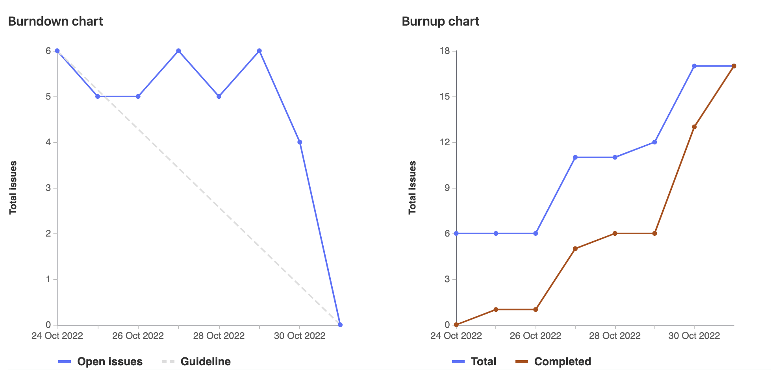
Burndown & Burnup chart(s)

Slide 6
Sprint 5 Highlights - Brandon Tu (1047332)
(4) Made NGINX redirect to the react portion’s build folder on the school vm
(4) Created a script that runs the backend flask code on port 5000
(3) Made NGINX look for the flask functions on port 5000 if it doesn’t exist in the react portion
Total: ~20

Slide 7
Sprint 5 highlight - Mussab Bin Imran (1111908)
Add in Flask paths to React, with Ibrahim and Himmat (4)
Create dummy flask paths, with Ibrahim and Himmat (4)
Documentation and Testing (2)
Total (22)

Slide 8
Sprint 5 Highlight - Chris Fitzgerald
Updated the uninstall script
Helped with flask stuff
Created the Wiki

Slide 9
Sprint 4 Highlight - Affan Khan(1095729)
Create flask paths
Update react app with new endpoints
Add in flask paths to react
Pair program with team members
Total weight: 20

Slide 10
Sprint 5 highlights - Himmat Mahal (1094444)
Pairing with Mussab, Ibrahim, Chris and Affan to create some flask http endpoints to grab course data
Also paired to integrate this with react frontend http requests
Meetings, documentation, and testing, miscellaneous

Slide 11
Sprint 5 Highlight - Ibrahim Rather (1097660)
Worked with Mussab, Himmat, Chris and Affan to create new flask endpoints to grab dummy course data
Worked with them to also then add these endpoints to the react app, and add functionality of clicking a button and displaying the data
Helped work on the wiki page
Did code cleanup, documentation, and testing
Total Weight: 22

